Slide 1
Know the covid-19 flirt variants
Maria Angelica Munar G
Program Health Coordinator/MD
LLHD

Slide 2
Variants of interest
Notes:
"Since the beginning of the pandemic, we have seen various strains and variants emerge over time. Currently, the FLiRT strains, which are subvariants of Omicron, account for the majority of COVID-19 cases in the U.S."

Slide 3
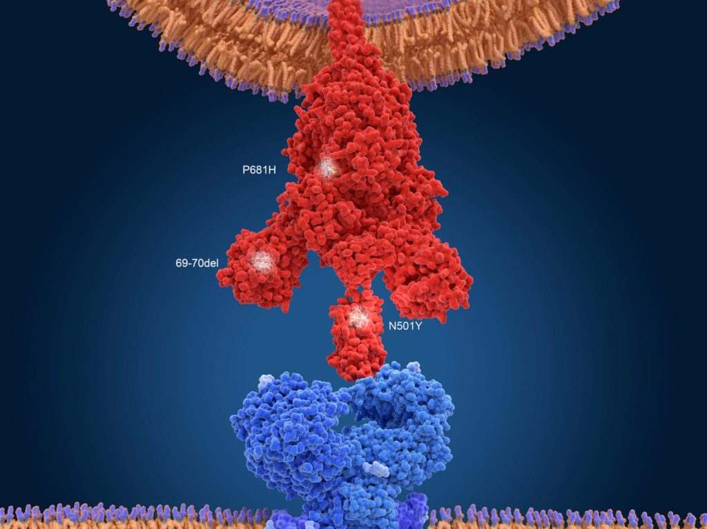
Flirt VARIANTS
This term is being used to describe a whole family of different variants starting with KP or JN
KP.1
KP.2
KP.3
Newer strain called LB.1
Notes:
"The COVID FLiRT group, consisting of new virus strains known as the FLiRT variants (named based on the technical details of their two mutations), began spreading, followed by the emergence of a variant known as LB.1 in June. Variants KP.1, KP.2, KP.3, and the newer LB.1 are all spinoffs of Omicron's JN.1. These variants have spike protein mutations that enhance their ability to evade prior immunity.“
Here’s an improved version of your text with refined clarity and flow:
---
**What are the “FLiRT variants”?**
The term "FLiRT variants" refers to a group of SARS-CoV-2 variants, including KP.2, JN.1.7, and other variants beginning with "KP" or "JN," that have independently acquired the same set of mutations through a process known as convergent evolution. These variants are all descendants of JN.1, which has been the dominant strain in the U.S. for the past few months.
The mutations that define the FLiRT variants, sometimes called “FLiPs,” occur at specific positions in the virus's spike protein—positions 456, 346, and 572. These changes help the virus evade immune detection.
Viruses like SARS-CoV-2 mutate frequently. When mutations help the virus evade antibodies, they often weaken its ability to bind to host cells. In response, the virus evolves further, gaining mutations that restore or even enhance its binding ability. This cycle of immune evasion and binding improvement is something virologists have observed repeatedly in SARS-CoV-2. The fact that multiple variants are acquiring the same mutations suggests that this combination of changes is particularly effective for the virus's survival and spread.
---
This revision improves clarity, simplifies technical explanations, and enhances readability while maintaining the original meaning.
The new variant of the SARS-CoV-2 coronavirus, B.1.1.7., was first identified in the U.K. in December. The red object is a spike protein of the coronavirus, and it interacts with the (blue) ACE2 receptor on the human cell to infect it. The mutations of the new variant are labeled, showing their position on the spike protein. Credit: Juan Gaertner/Science Photo Library

Slide 4
Covid-19 activity
The predominant COVID-19 variant is KP.3.1.1
Has mutations that allow it to evade previous immunity from vaccines or infections.
COVID-19 activity, including hospitalizations and test positivity rates, has remained elevated, especially among older adults and young children.
Wastewater data also shows high viral activity across the country
Notes:
As of October 2024, the predominant COVID-19 variant in the U.S. is KP.3.1.1, which has emerged from the Omicron lineage. This variant, along with other Omicron offshoots like XBB.1.5, has mutations that allow it to evade previous immunity from vaccines or infections. The CDC continues to monitor these variants using genomic surveillance to track their spread.
COVID-19 activity, including hospitalizations and test positivity rates, has remained elevated, especially among older adults and young children. Wastewater data also shows high viral activity across the country. Staying updated with COVID-19 vaccines is strongly recommended by the CDC to reduce the risk of severe illness

Slide 5
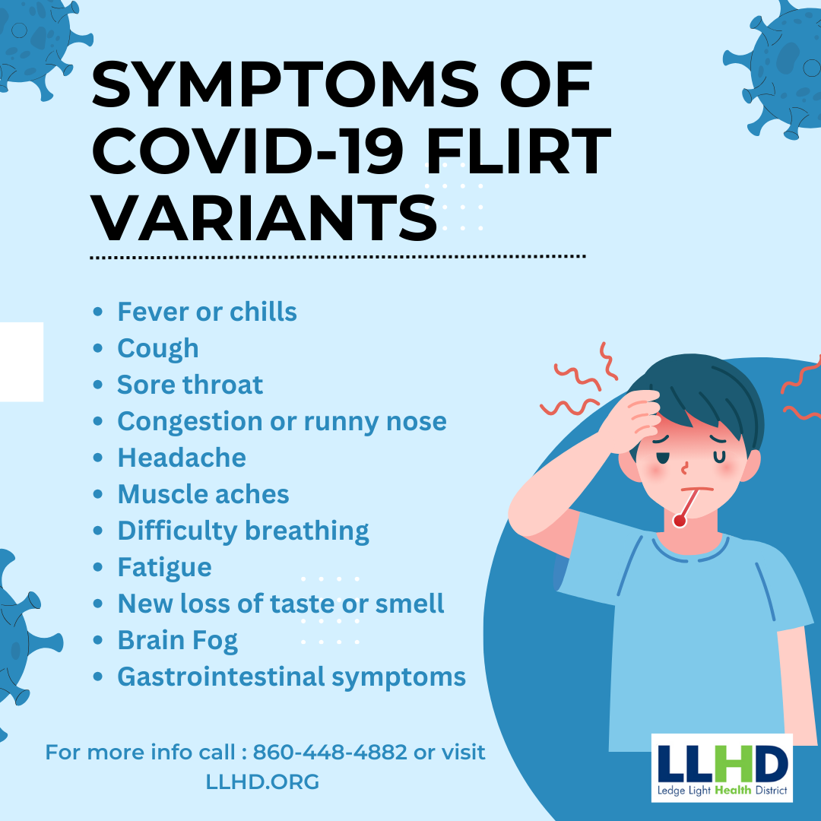
Symptoms of flirt variants
Notes:
Like the JN.1 and previous omicron variants, the infectiousness period is the same: symptoms may develop five or more days after exposure and one is contagious a day or two before experiencing symptoms as well as a few days after they subside.

Slide 6
ISOLATION GUIDANCE AND PREVENTION

Slide 7
Fall-winter vaccine recommendation
Everyone ages 6 months and older should get a 2024–2025 COVID-19 vaccine.
The COVID-19 vaccine helps protect you from severe disease, hospitalization, and death.
It is crucial to get your 2024–2025 COVID-19 vaccine if you are ages 65 and older, are at high risk for severe COVID-19, or have never received a COVID-19 vaccine.
Vaccine protection decreases over time, so staying up to date with your COVID-19 vaccine is important.
Notes:
On August 22, 2024, the U.S. Food and Drug Administration (FDA) approved and authorized the 2024-2025 mRNA COVID-19 vaccines formulated to target currently circulating variants and to provide better protection against serious consequences of COVID-19, including hospitalization and death.
It is recommended that everyone ages 6 months and older get the 2024–2025 COVID-19 vaccine. This includes people who have received a COVID-19 vaccine before and people who have had natural infection.
Getting the 2024–2025 COVID-19 vaccine is important because:
Protection from the COVID-19 vaccine decreases with time.
COVID-19 vaccines are updated to give you the best protection from the currently circulating strains.

Slide 8
High risk conditions for severe covid-19 infection

Slide 9
Thank you!
Because immunity wanes and COVID keeps finding ways to change, infect, and spread, staying up to date on the vaccine is important.

